Slide 1
NFT hype is a bust

Slide 2
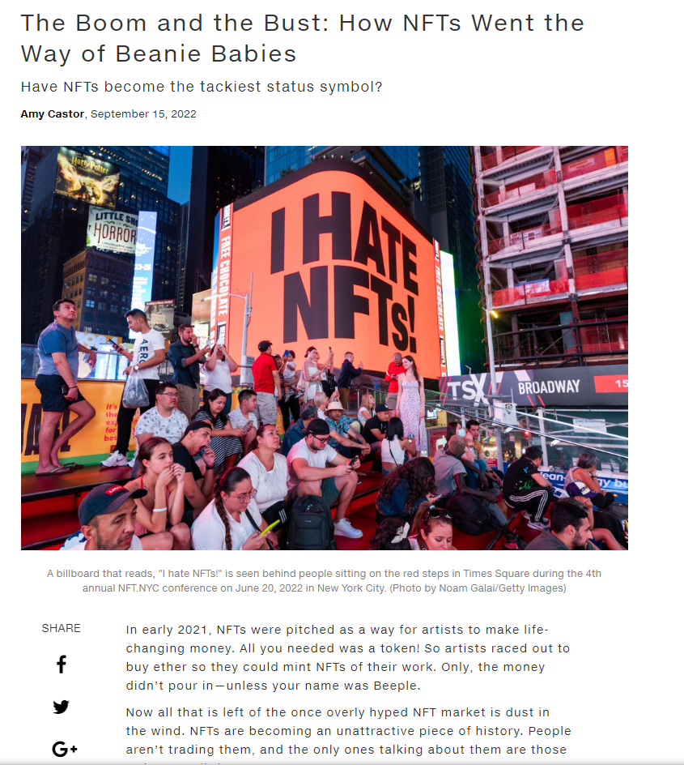

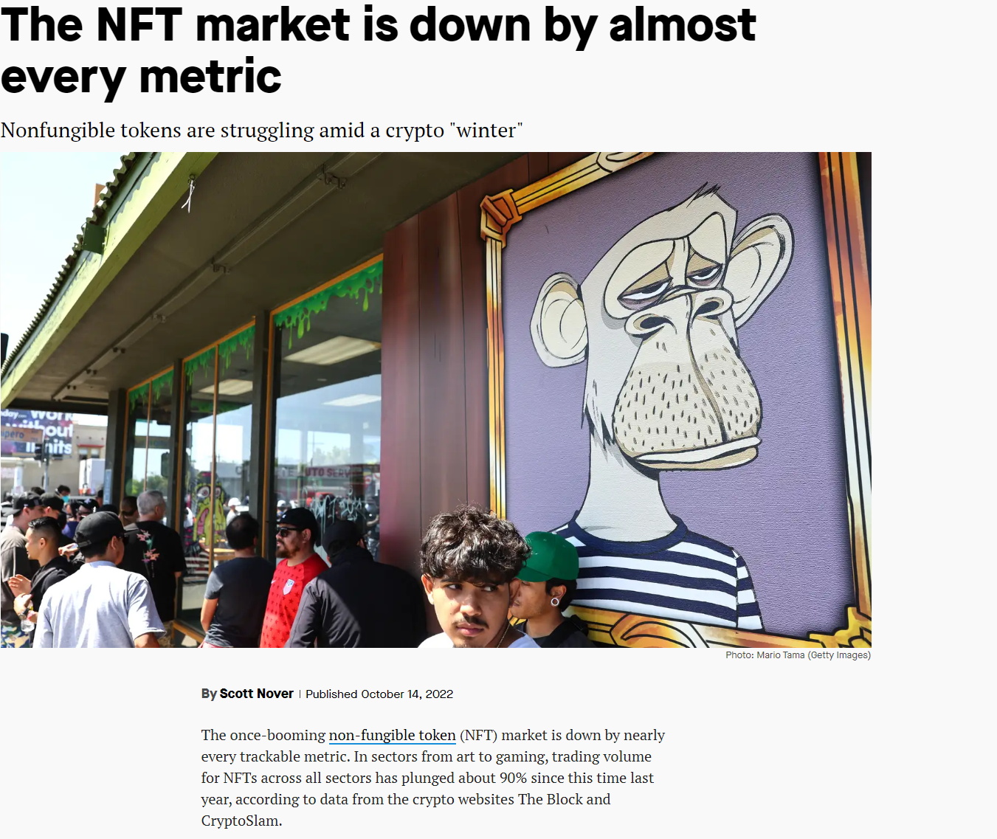

Slide 3
What are NFTs?
Unique digital item
Blockchain
Unique identification codes for authenticity

Slide 4
NFTs VS cryptocurrencies
NFTs
Cryptocurrencies
Cannot be traded at equivalency
Is a digital item
Can be replicated
Is a digital currency
Can be divided in smaller parts

Slide 5
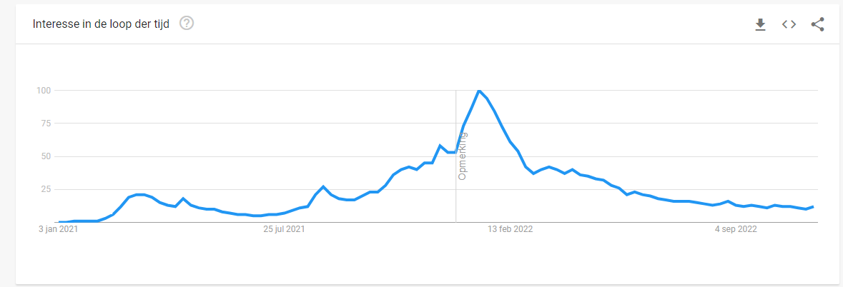
NFTs are dying
Number of investors → dropping
Investing in safer vehicles
Less interest in this market
Sales volume is dropping

Slide 6
Summary
NFT → unique digital item
Uses the blockchain
NFTs ≠ Cryptocurrencies
Number of investors are dropping
Less interest in this market
Sales volume is dropping

Slide 7
Q&A
Now I will answer some questions

Slide 8
The end of my presentation

